Slide 1
Course: Cloud, Microservices and Applications
UNIT II: Virtualization
SESSION 8
Characteristics
Date: 30/7/2021

Slide 2
What is Virtualization?
Virtualization is a broad concept that refers to the creation of a virtual version of something, whether hardware, a software environment, storage, or a network.
In a virtualized environment there are three major components: guest, host, and virtualization layer

Slide 3
Hardware virtualization
The guest is represented by a system image comprising an operating system and installed applications.
These are installed on top of virtual hardware that is controlled and managed by the virtualization layer, also called the virtual machine manager.
The host is instead represented by the physical hardware, and in some cases the operating system, that defines the environment where the virtual machine manager is running.
The guest— applications and users—interacts with a virtual network, such as a virtual private network (VPN)

Slide 4
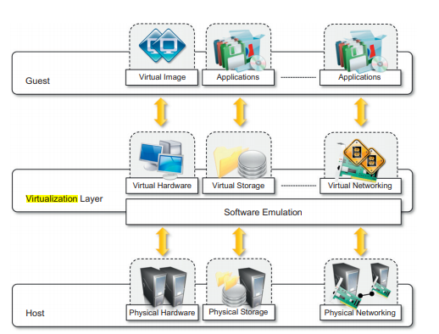
The virtualization reference model
Image SOurce: Rajkumar Buyya, S. Thamarai Selvai, “Mastering Cloud computing and application programming”,1st Edition, Elsevier, 2013

Slide 5
Characteristics of Virtualization
Increased security
Managed execution
Portability

Slide 6
Increased security
The virtual machine represents an emulated environment in which the guest is executed.
All the operations of the guest are generally performed against the virtual machine, which then translates and applies them to the host.
This level of indirection allows the virtual machine manager to control and filter the activity of the guest, thus preventing some harmful operations from being performed.

Slide 7
Increased security
Resources exposed by the host can then be hidden or simply protected from the guest
Increased security is a requirement when dealing with untrusted code
By default, the file system exposed by the virtual computer is completely separated from the one of the host machine

Slide 8
Managed execution
Virtualization of the execution environment not only allows increased security, but a wider range of features also can be implemented.
In particular, sharing, aggregation, emulation, and isolation are the most relevant features (Refer Figure)

Slide 9
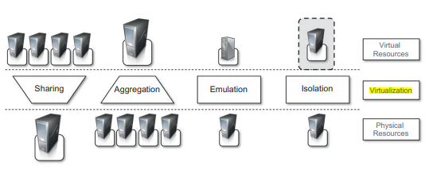
Managed execution
Image Source: Rajkumar Buyya, Christian Vecchiola, S. Thamarai Selvi, “Mastering Cloud Computing foundations and application programming”,1st Edition, Elsevier, 2013.

Slide 10
Managed execution
Sharing:
Virtualization allows the creation of a separate computing environments within the same host.
In this way it is possible to fully exploit the capabilities of a powerful guest, which would otherwise be underutilized.
Sharing is a particularly important feature in virtualized data centers, where this basic feature is used to reduce the number of active servers and limit power consumption

Slide 11
Managed execution
Aggregation:
Not only is it possible to share physical resource among several guests, but virtualization also allows aggregation, which is the opposite process.
A group of separate hosts can be tied together and represented to guests as a single virtual host.
This function is naturally implemented in middleware for distributed computing, with a classical example represented by cluster management software

Slide 12
Managed execution
Emulation:
Guest programs are executed within an environment that is controlled by the virtualization layer, which ultimately is a program.
This allows for controlling and tuning the environment that is exposed to guests.
For instance, a completely different environment with respect to the host can be emulated, thus allowing the execution of guest programs requiring specific characteristics that are not present in the physical host

Slide 13
Managed execution
Isolation.:
The guest program performs its activity by interacting with an abstraction layer, which provides access to the underlying resources.
Isolation brings several benefits; for example, it allows multiple guests to run on the same host without interfering with each other.
Second, it provides a separation between the host and the guest.
The virtual machine can filter the activity of the guest and prevent harmful operations against the host.

Slide 14
Managed execution
Performance Tuning
It becomes easier to control the performance of the guest by finely tuning the properties of the resources exposed through the virtual environment.
This capability provides a means to effectively implement a quality-of-service (QoS) infrastructure that more easily fulfills the service-level agreement (SLA) established for the guest

Slide 15
Managed execution
Another advantage of managed execution is that sometimes it allows easy capturing of the state of the guest program, persisting it, and resuming its execution

Slide 16
Portability
The concept of portability applies in different ways according to the specific type of virtualization considered.
In the case of a hardware virtualization solution, the guest is packaged into a virtual image that, in most cases, can be safely moved and executed on top of different virtual machines.
Except for the file size, this happens with the same simplicity with which we can display a picture image in different computers.
Virtual images are generally proprietary formats that require a specific virtual machine manager to be executed

Slide 17
Portability
This makes the application development cycle more flexible and application deployment very straightforward: One version of the application, in most cases, is able to run on different platforms with no changes.
Finally, portability allows having your own system always with you and ready to use as long as the required virtual machine manager is available

Slide 18
Any Questions???

Slide 19
Thank You

